Slide 1
XN PROJECT PRESENTATION Professor Name: Sharad Shandilya, Ph.D. CPS Term: Winter 2021
Presented by:
Gitesh Poudel
Linqian Shen
Mai Do
Sravanthi Chava
Quoc Tuong Dong

Slide 2

ALICORN AIM OF THE ANALYSIS
Finding out the startup which gives high returns to the investors in software DevOps sector.
Analyze the trend of investment and returns.
Building predictive models to support the next investment

Slide 3
OUR PROJECT PROCESS
Data cleaning and preparation
Perform the analysis guide components
EDA analysis
Results
Dealing with missing data, Anomaly Detection
Feature Engineering,
Boruta Analysis,
Predictive modeling
Answer Sponsor’s questions + conclusion
Using Tableau and correlation matrix

Slide 4


Exploratory Data Analysis (EDA)

Slide 5
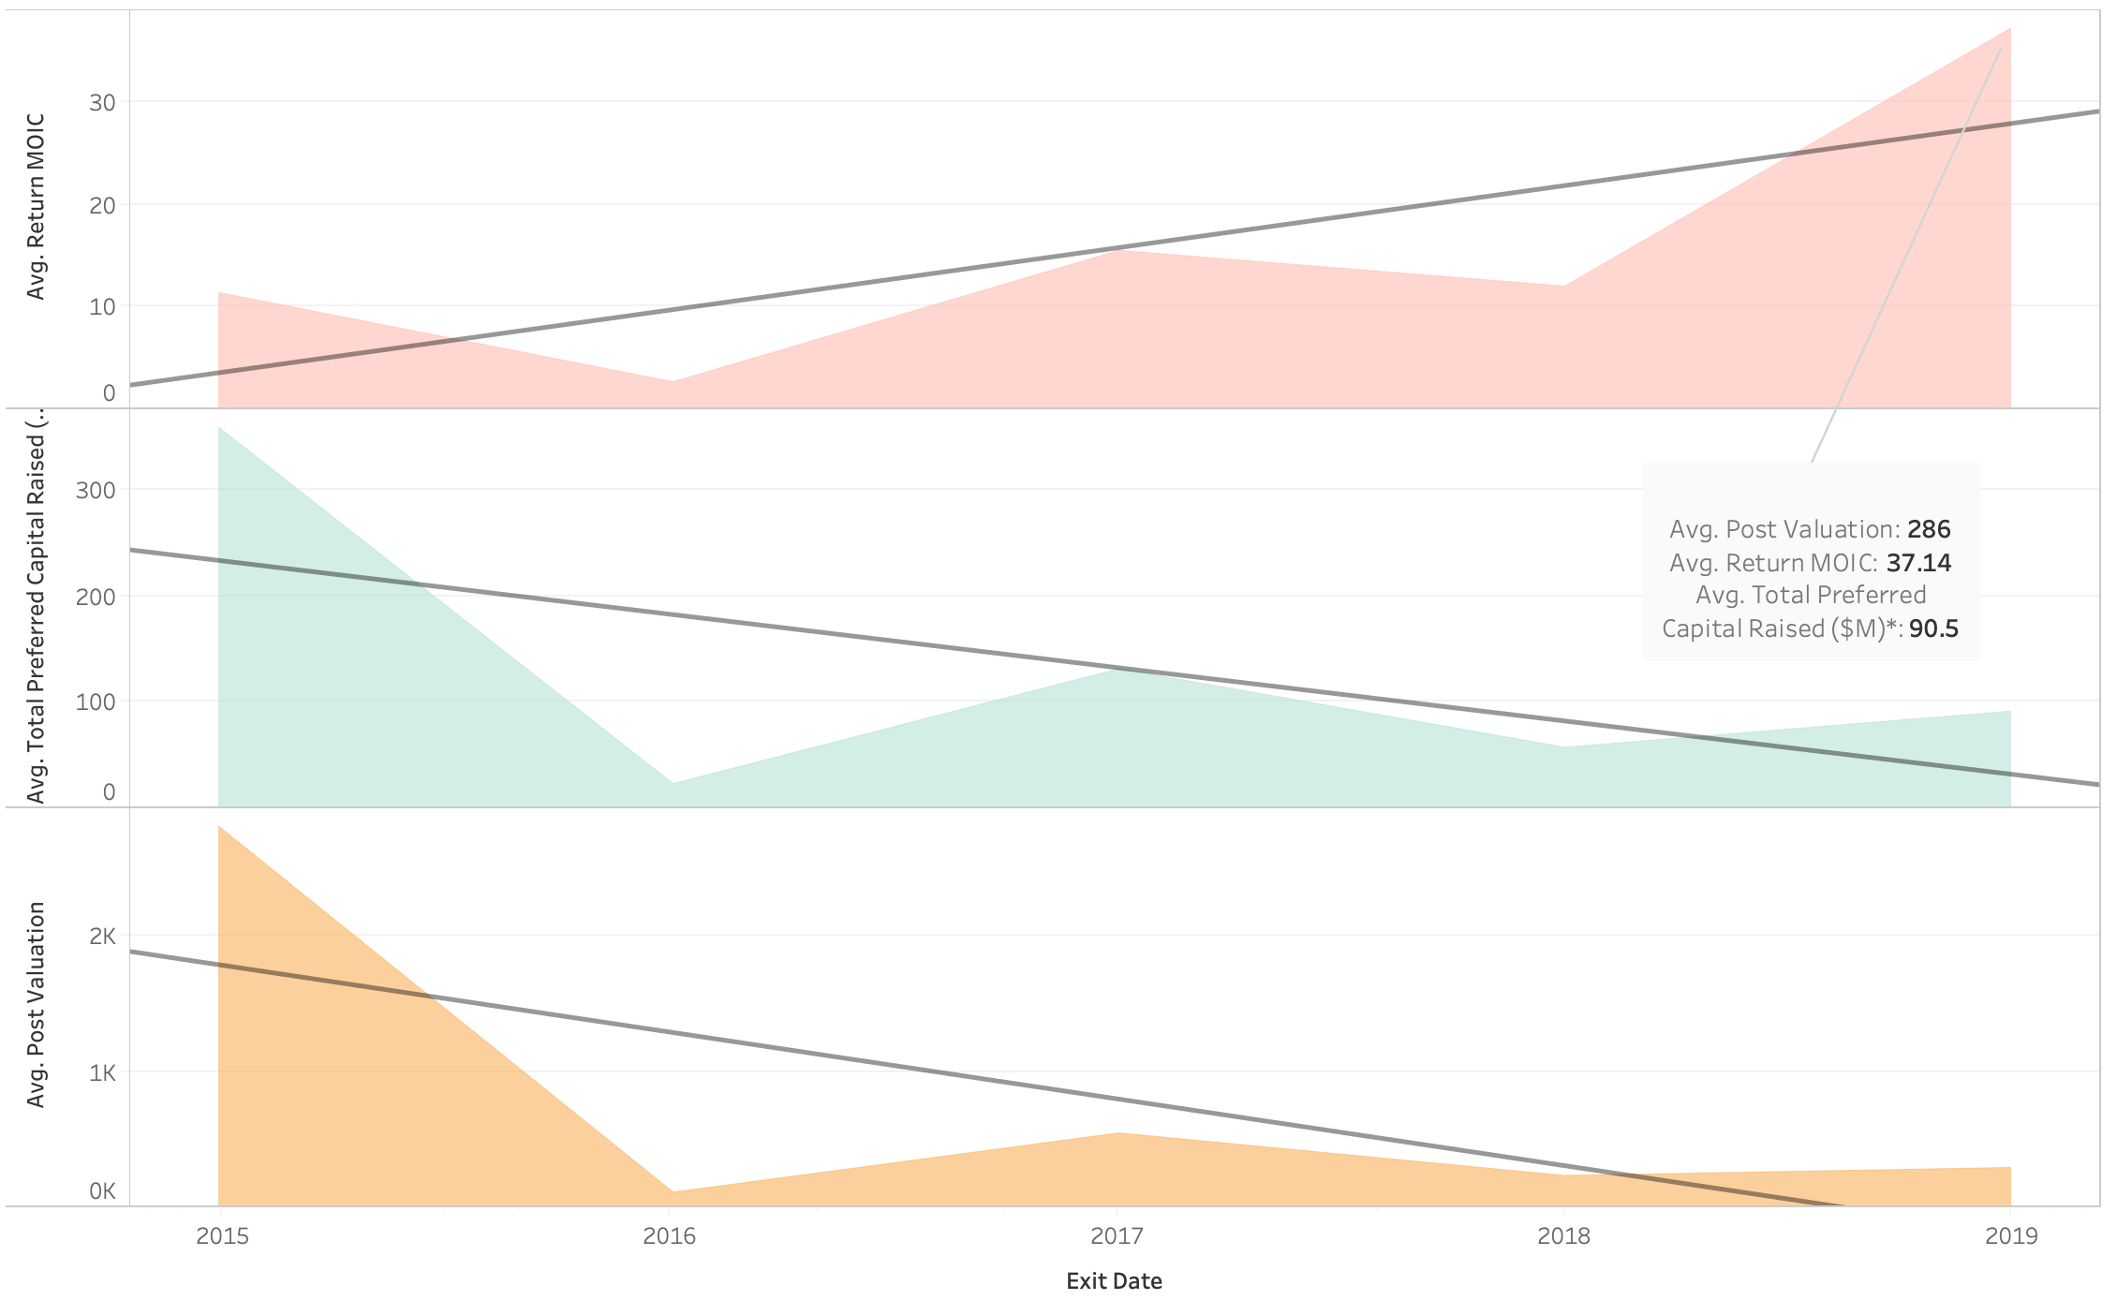
Return MOIC, Total Capital Raised and Post valuation trends from 2015 to 2019
Overall, the Return MOIC has the opposite trend when it increased slightly while the value of Total Preferred Capital Raised and Post valuation decreased from 2015 to 2019.

Slide 6
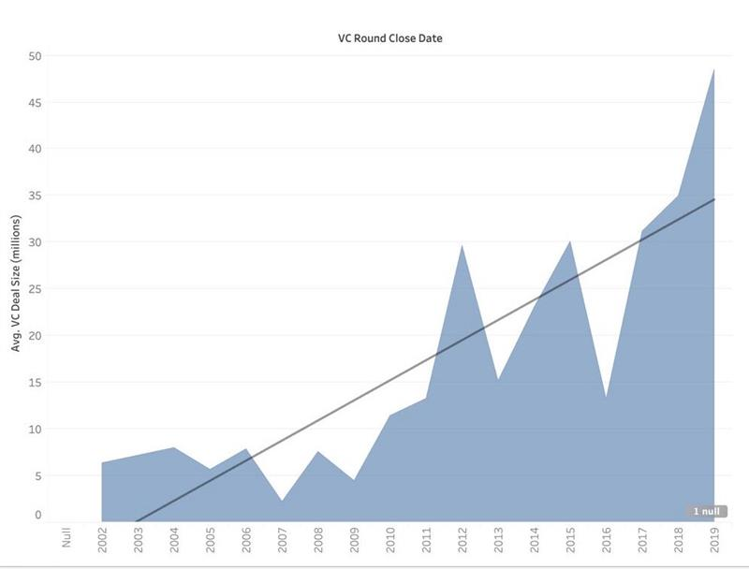
VC Deal size and VC Round Close Date trend from 2002 to 2019
VC deal size trend increases from 2002 to 2019
We see a spark growth of VC deal size in 2012, 2015 and 2019.

Slide 7
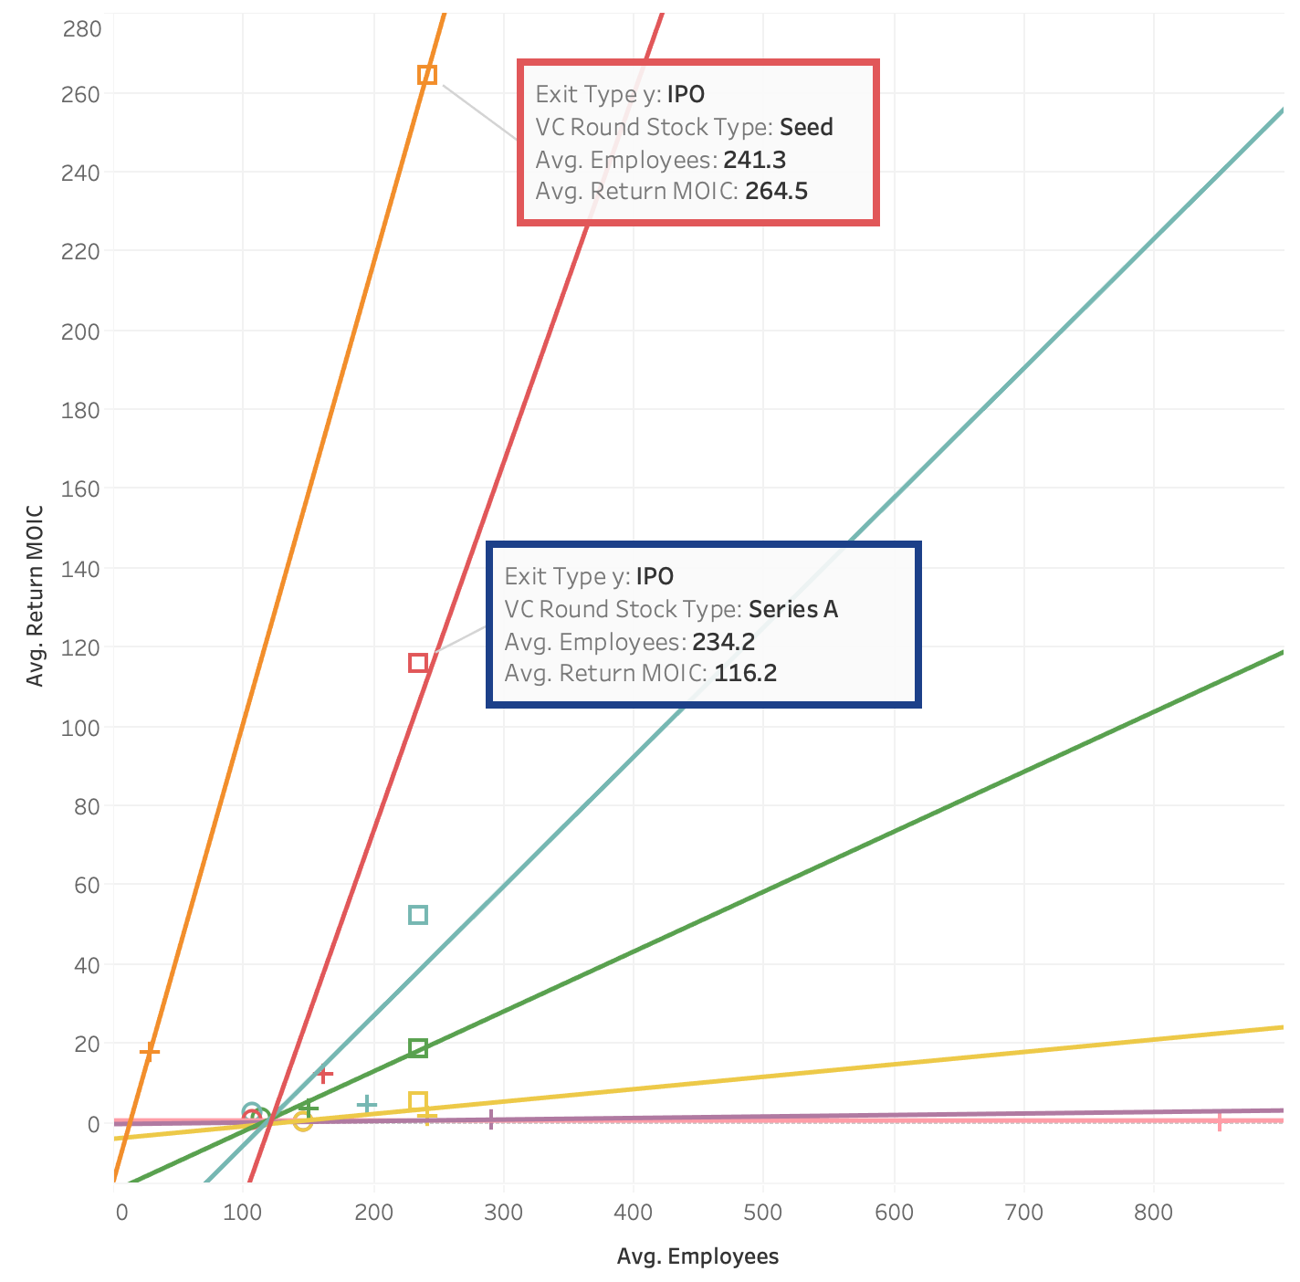
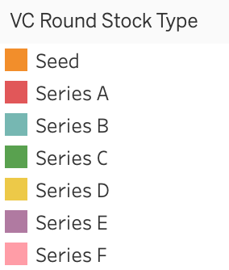

Relationship between Return MOIC, Employees, VC Round Stock Type and Exit Type
The highest return MOIC belong to Seed and series A, following is series B and C (early-stage startups)
The relationship between Return MOIC with number of employee is positive, which mean the companies that have more employees will have higher return MOIC
The highest return is 264.5 with 241 employees in seed round.

Slide 8
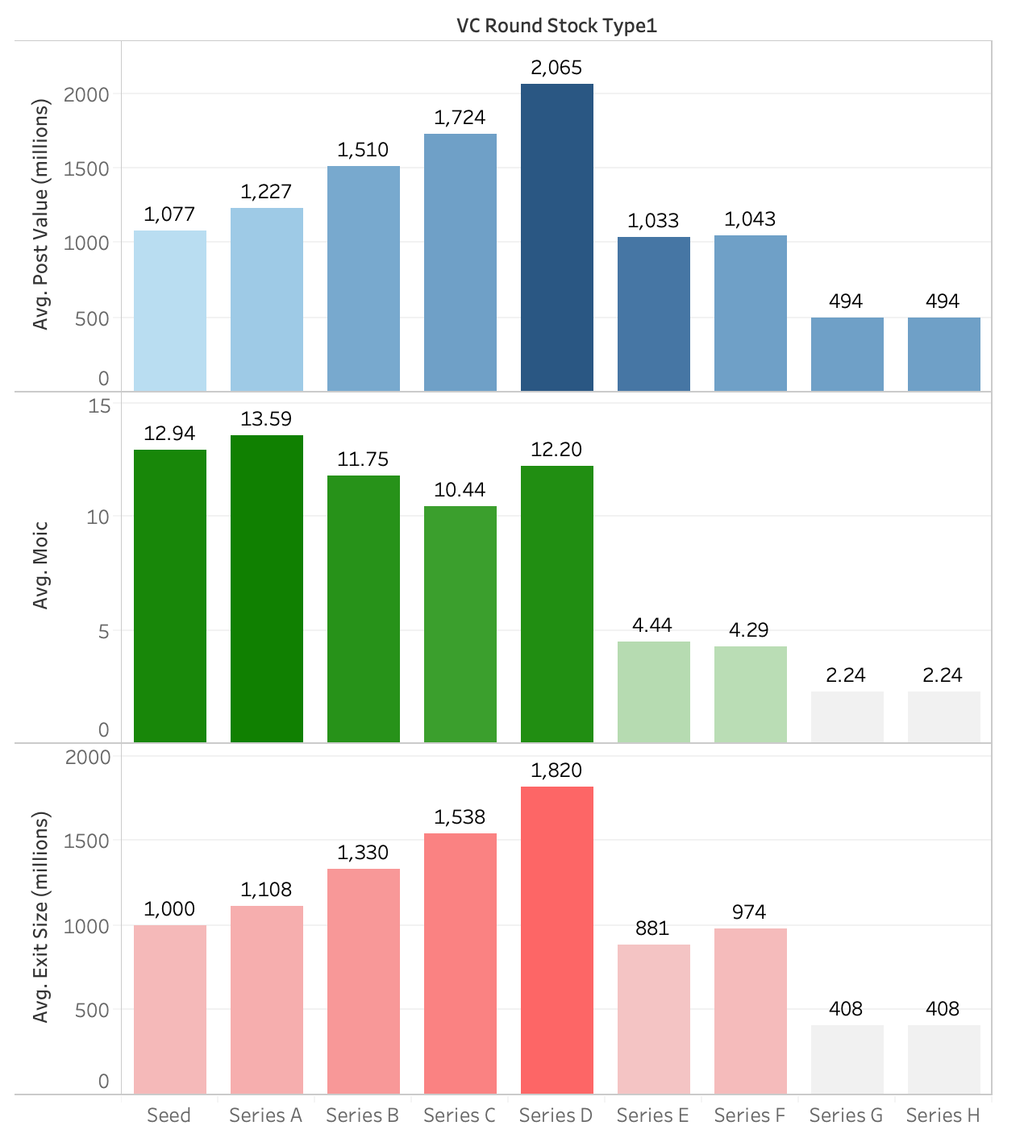
MOIC, Post Value and Exit Size by different VC Round Stock Type
Overall, Post Value, MOIC and Exit Size are high value from Seed to series D (Early-stage investment) and then lower from series E

Slide 9
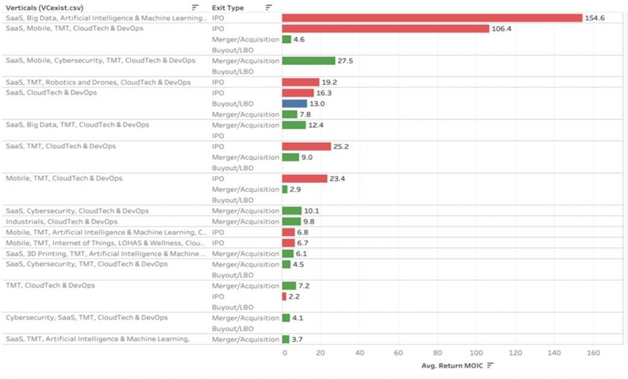
Return MOIC, Exit type by different Verticals
The verticals such as SaaS, Artificial Intelligence & Machine Learning, TMT, Big Data, Cloud Tech & DevOps have the highest return with more than 154.6 return MOIC with exit type is IPO.

Slide 10
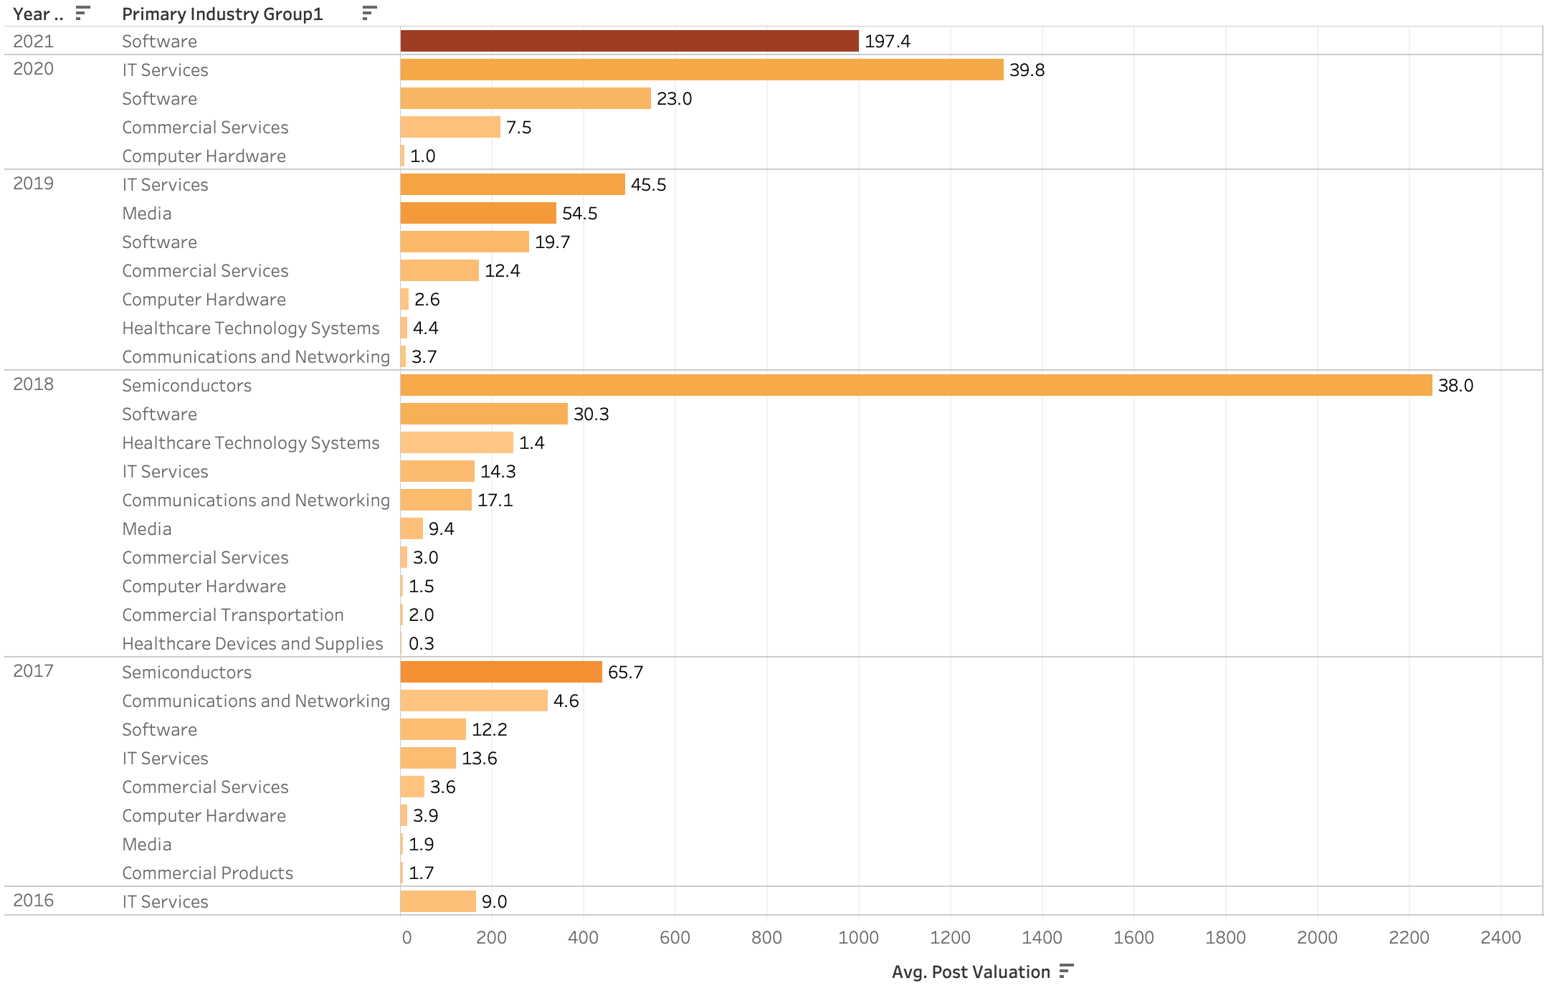
Post Valuation from primary industries from 2015 to 2021

Slide 11
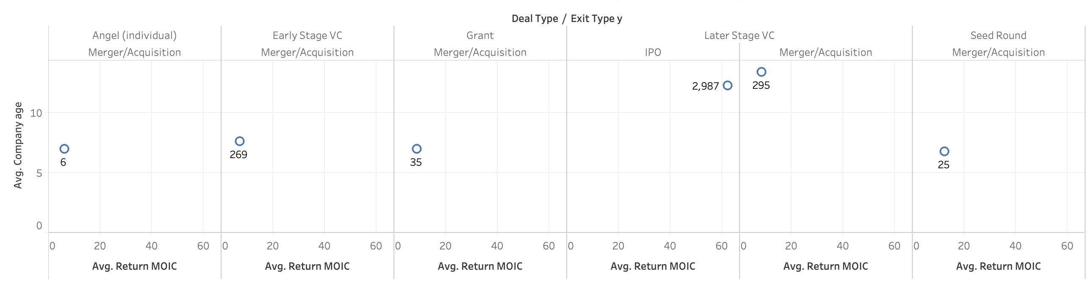
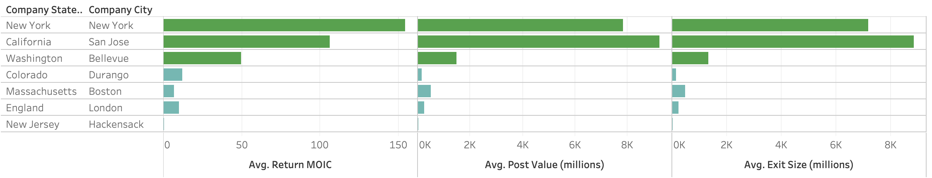
Relationship between Return MOIC, Company age, Deal Type and Exit Type
Top locations of startups that have high return MOIC

Slide 12
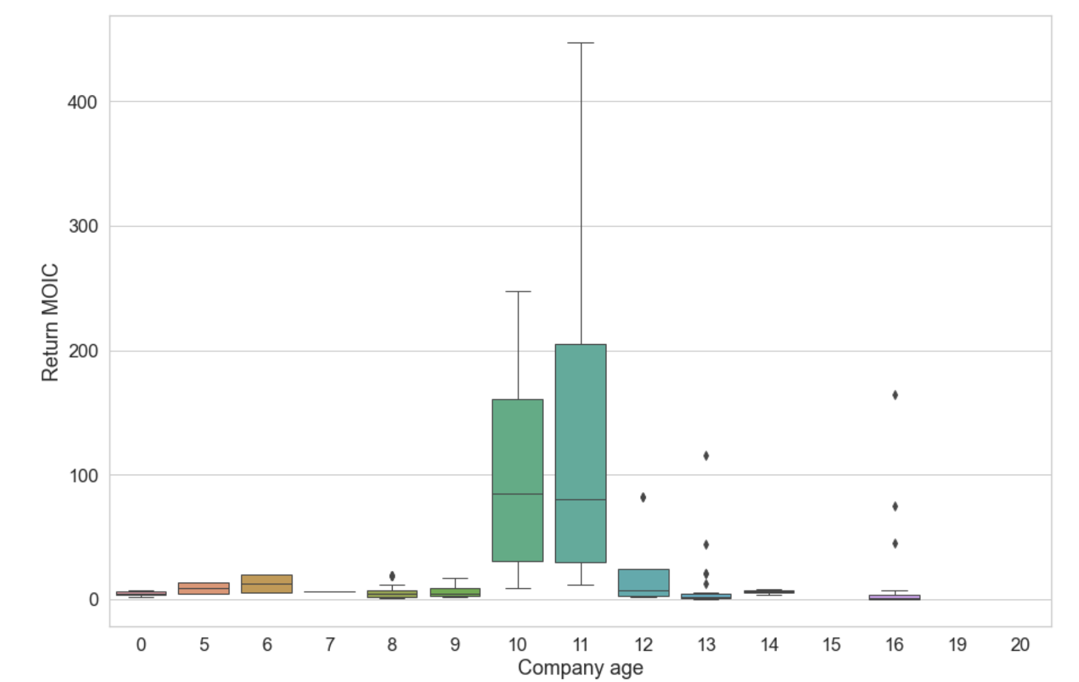
Relationship of Company Age & Return MOIC
Companies with 11 years old have the highest return MOIC with more than $200M

Slide 13
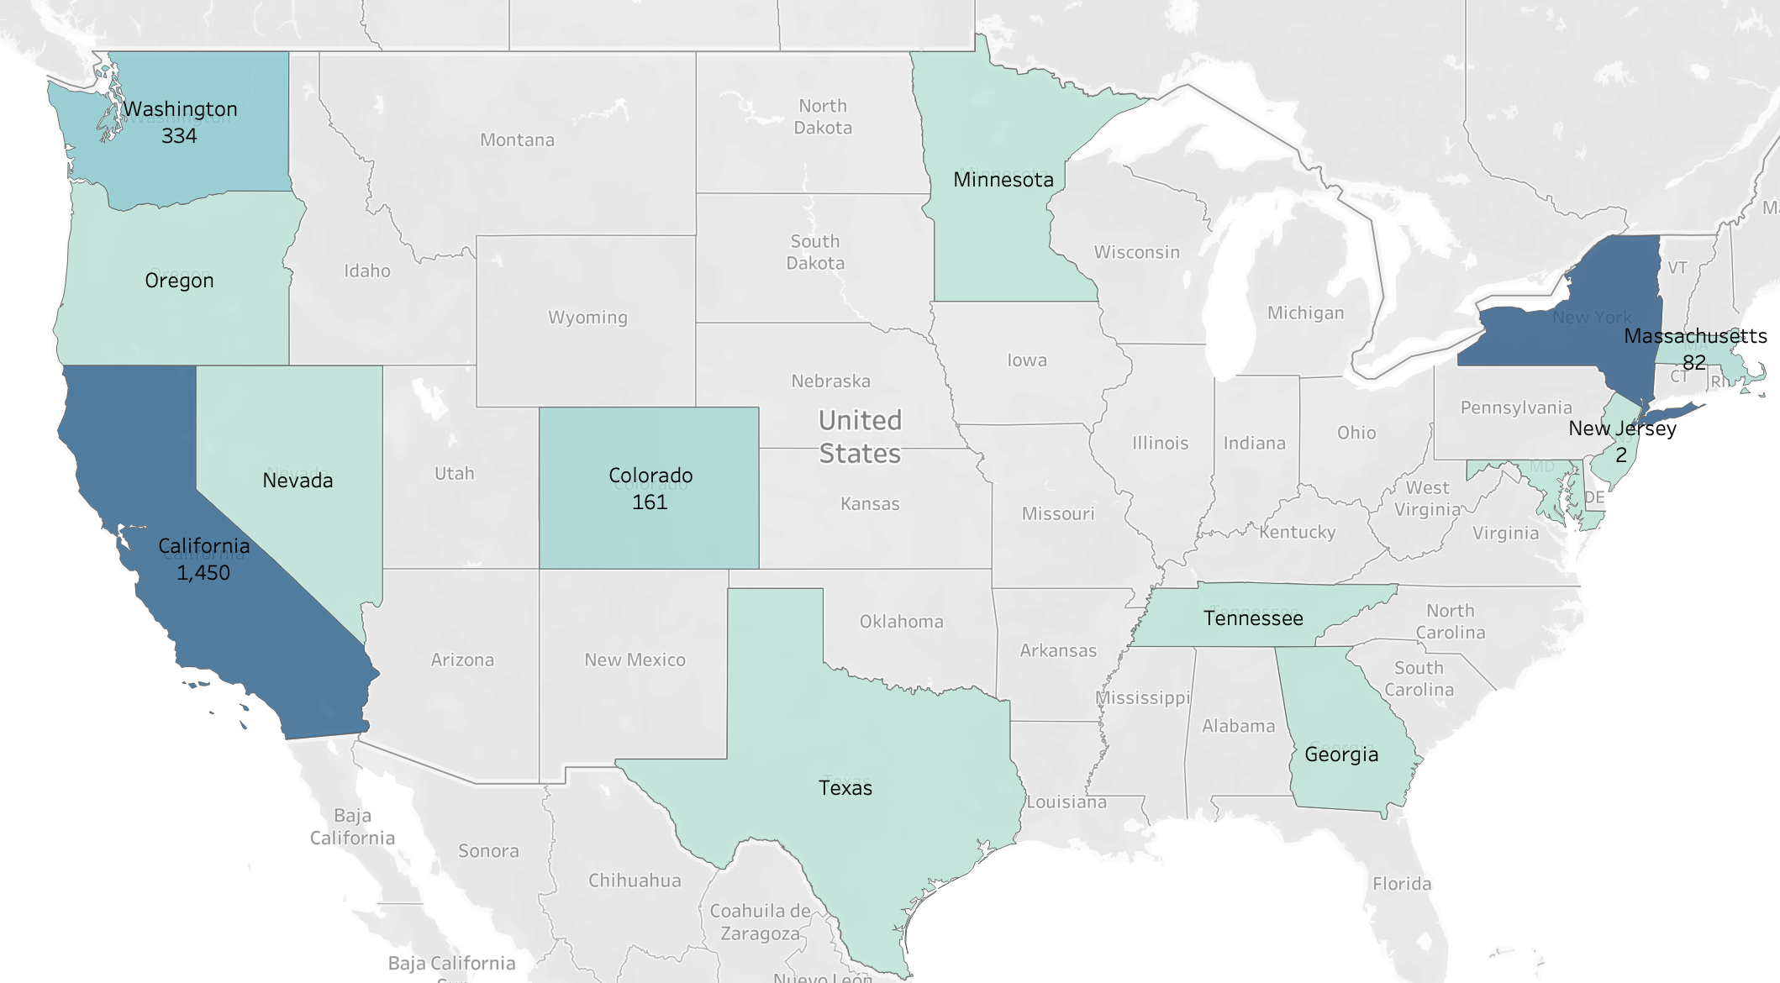
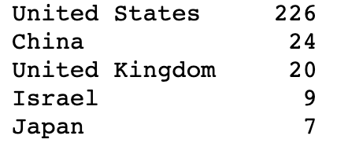
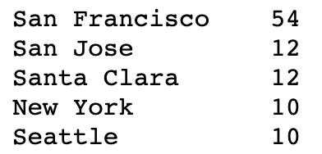
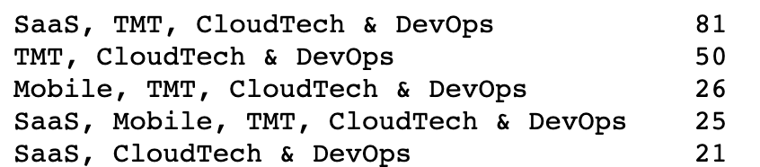
Return MOIC distribution in the USA
Top 5 countries got funding
Top 5 cities got funding
Top 5 verticals got funding

Slide 14
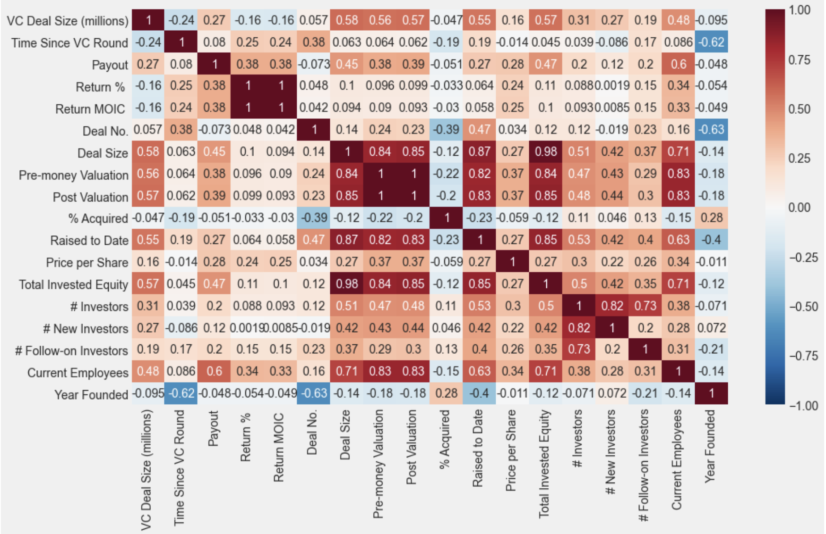
Correlation between features

Slide 15
Data cleaning and preparation
BigML Script
VCexits and Returns Dataset was treated Using WhizzML script “Auto-complete Missing Fields”
Statistical Inferences
Missing data in DevOps Data was filled manually by statistical inferences (Mean, Median)
These dataset contains sensitive financial information. Hence, we used a BigML native script which trains individual ensemble and predicts missing value for each feature.
DevOps dataset have huge dimension, many of variable are missing significantly huge portion of dataset. BigML script failed to impute missing value due to the lack of data available. Hence, manual imputation methods were used.

Slide 16
Predictive modeling

Slide 17
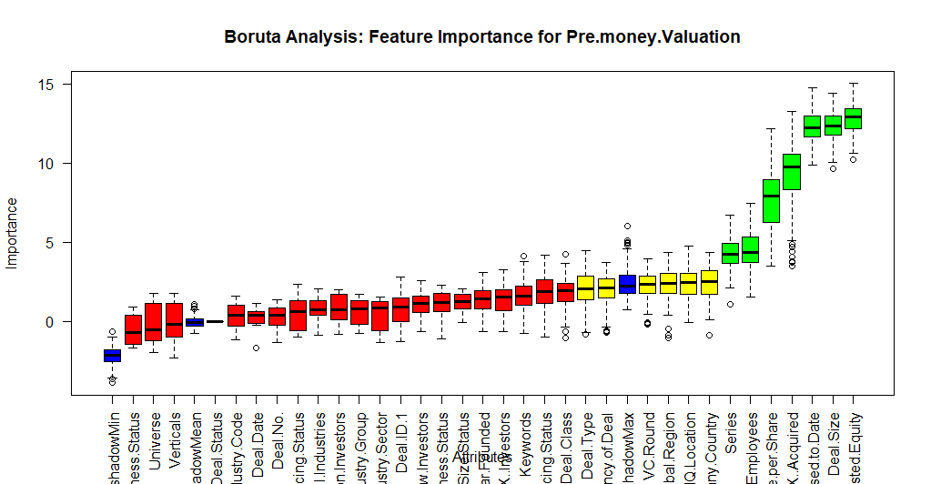
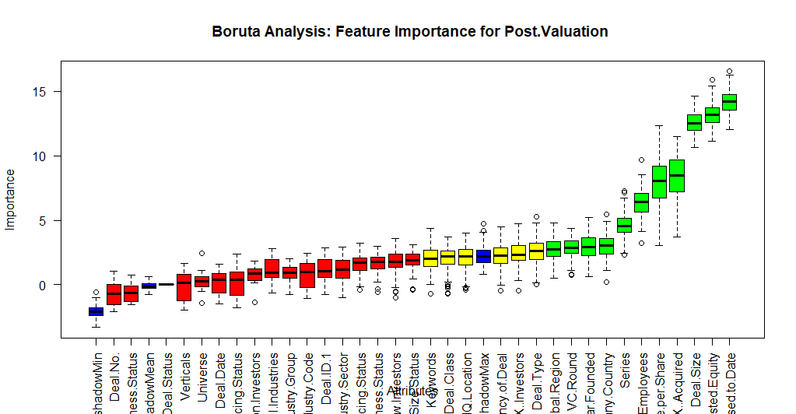
DevOps
BORUTA FEATURE ENGINEERING
Adds randomness to the given data set by creating shuffled copies of all features
Trains a random forest classifier on the extended data set and applies a feature importance measure
Checks at every iteration whether a real feature has a higher importance than the best of its randomized features
Stops either when all features gets confirmed or rejected or it reaches a specified limit of random forest runs

Slide 18
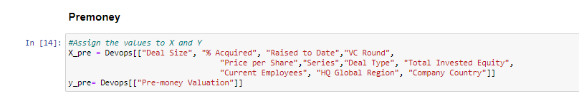
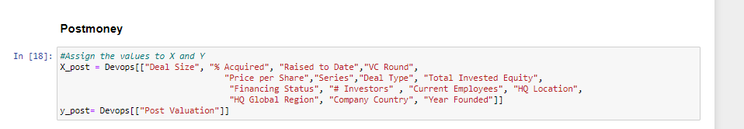
DevOps
BORUTA FEATURE ENGINEERING (cont)
Pre-Valuation: 36---> 12 variables
Post-Valuation: 36---> 15 variables
3 additional variables are: "Financing Status” (Venture Capital Backed, Angle Backed, Corporations, etc.), "# Investors”, and “Year founded”

Slide 19
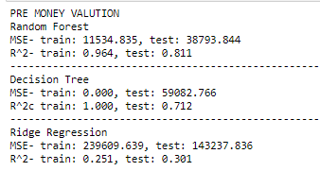
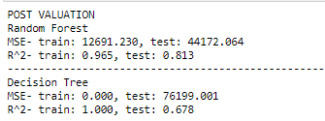
DevOps
MODEL BUILDING
Regression prediction for Pre-Valuation and Post-Valuation:
Random Forest
Decision Tree
Ridge Regression
➔ Choose Random Forest

Slide 20
DevOps
OPTIMIZATION (solve the Over-fitting problem)
Performed the K folds Cross Validation for 10 folds with the R^2 as the main metric
Performed Grid-Search to find best parameters for the best R^2

Slide 21
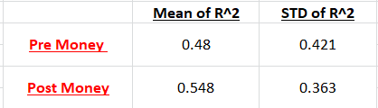
DevOps
OPTIMIZATION (solve the Over-fitting problem)
Applying the parameters to the models and see the changes

Slide 22
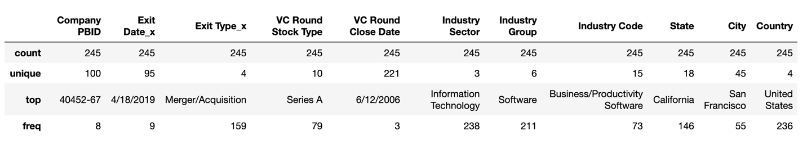
Returns by Series
This dataset includes details about Investor returns by series of 245 companies along with financial and company details
Categorical feature such as Industry sector, group, code and vertical carry a lot of information about the company and exit. Some of them are encoded using label and some are treated with one hot encoding.

Slide 23
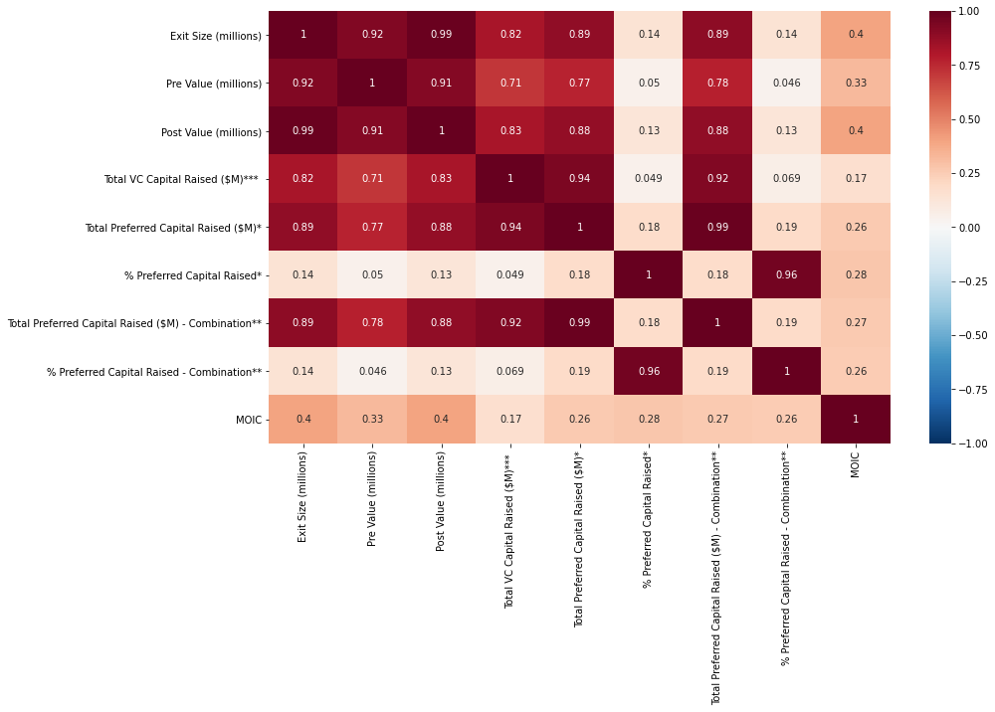
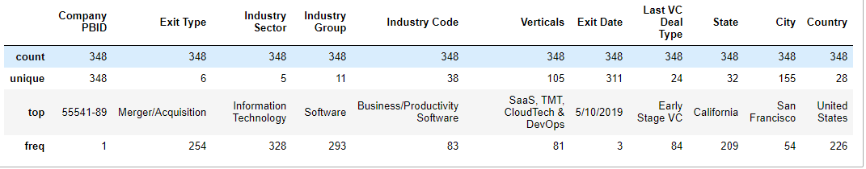
VC Exits
This dataset includes details about Acquisition and exits of 348 companies along with financial and company details
Before modeling, dependent variable with high correlation with each other are treated to ensure model is not influenced by multicollinearity

Slide 24
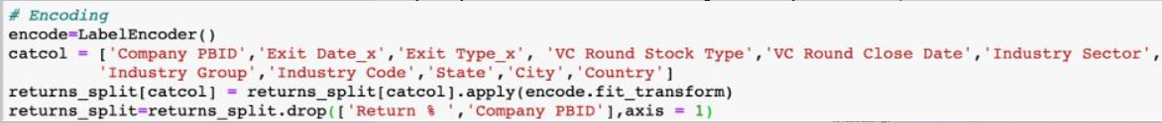
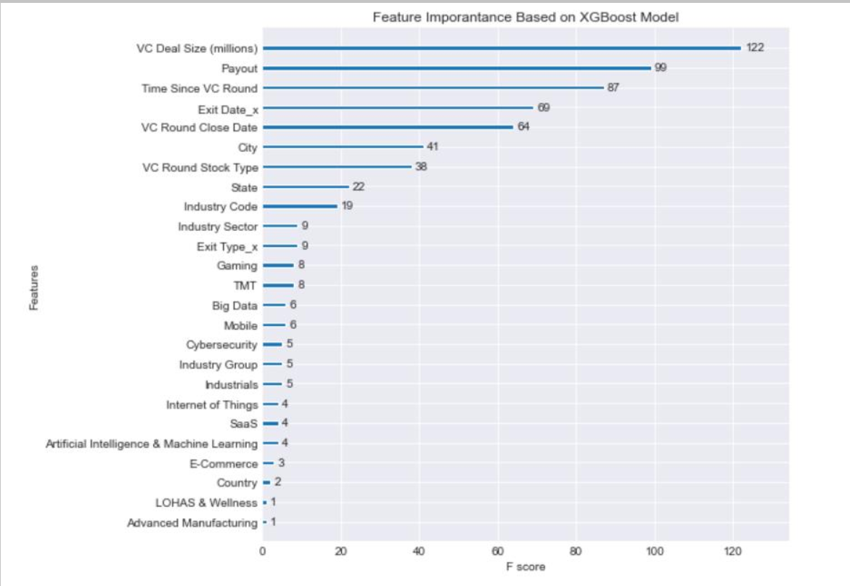

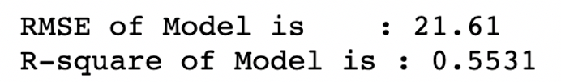
XGBoosting Regressor
Target: Return MOIC
Dataset of 245 records split into 7:3 ratio for training and testing, respectively.

Slide 25
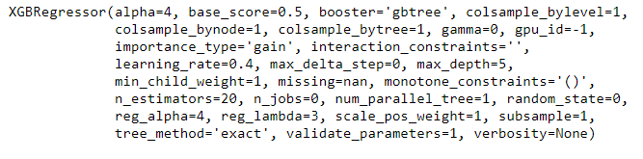

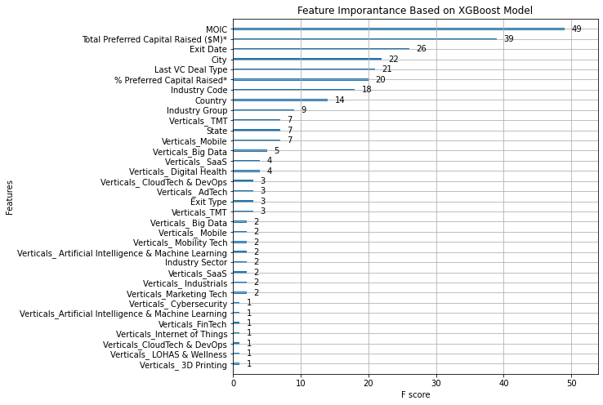
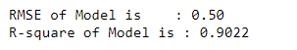
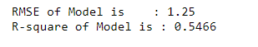
Target: Post Value
Model hyper-parameters:
This model predicts the Post valuation of any company after VC Exit.
Dataset of 348 instances split into 7:3 ratio for training and testing, respectively.
Model evaluation on training set:
Model evaluation on testing set:

Slide 26

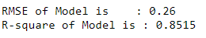
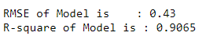
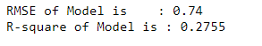
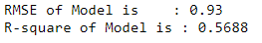
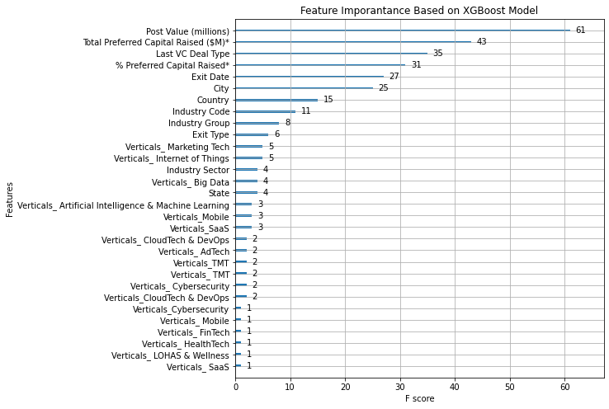
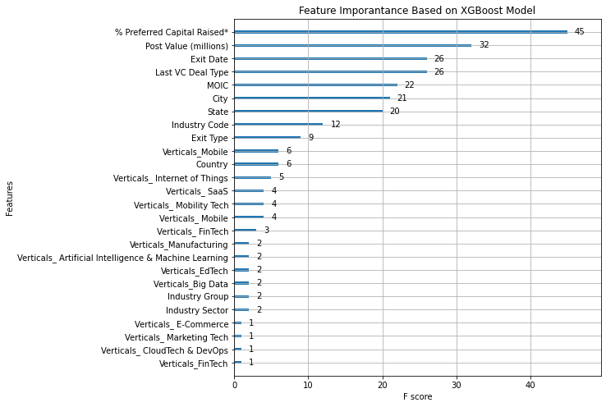
Target: MOIC
Target: Total Preferred Capital Raised
Model evaluation on training set:
Model evaluation on training set:
Model evaluation on testing set:
Model evaluation on testing set:

Slide 27
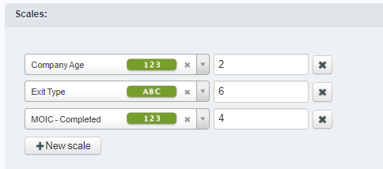

Unsupervised Model
Divide data instances into different group based on:
Exit type
MOIC (return of investment)
Age of company.
G-means algorithm-generated 6 clusters from total 292 instances:
Biggest cluster contain 28.42% (83 instances)
Smallest cluster contains 3.08% (9 instances).
➔ The generated clusters are interpretable and distinguished based on selected three features.

Slide 28
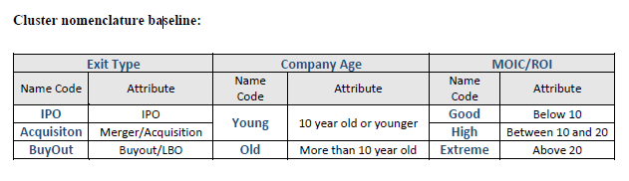

IPO Old Good Returns (30) | IPO Old Extreme Returns (9)
Exit Type: IPO Avg. MOIC: 45.03 Avg. Company Age: 13.89 Avg. No. of Employee: 711 Industry: Entertainment Verticals: VR, AR, Cloud Tech & DevOps, Gaming Avg. Exit/Pre/Post size ($): 8.5B, 8.8B, 9.5B Common Last VC Deal: Later Stage VC | Exit Type: IPO Avg. MOIC: 8.54 Avg. Company Age: 12.37 Avg. No. of Employee: 2514 Industry: Business/Productivity Software Verticals: Big Data, AI, Cybersecurity, Mobility Tech Avg. Exit/Pre/Post size ($): 1.3B, 1.9B, 1.2B Common Last VC Deal: Later Stage VC
Buyout Young High Returns (35)
Exit Type: Buyout/LBO Avg. MOIC: 11.01 Avg. Company Age: 7.04 Avg. No. of Employee: 103 Industry: Software Development Verticals: Avg. Exit/Pre/Post size ($): 0.72B, 2.3B, 0.54B Common Last VC Deal: Early-Stage VC

Slide 29
Acquisition Young High Returns(83) | Acquisition Young Extreme Returns(14)
Exit Type: Merger/Acquisition Avg. MOIC: 11.93 Avg. Company Age: 7.04 Avg. No. of Employee: 38 Industry: Business/Productivity Software Verticals: AI, Big Data, SaaS, TMT Avg. Exit/Pre/Post size ($): 0.72B, 2.4B, 0.69B Common Last VC Deal: Series A | Exit Type: Merger/Acquisition Avg. MOIC: 23.24 Avg. Company Age: 10.04 Avg. No. of Employee: 318 Industry: Automation/Workflow Software Verticals: Robotics and Drones, AI, 3D printing, Cloud Tech & DevOps, SaaS Avg. Exit/Pre/Post size: 1.1B, 1.1B, 1.1B Common Last VC Deal: Early-Stage VC
Acquisition Old Good Returns (121)
Exit Type: Merger/Acquisition Avg. MOIC: 7.43 Avg. Company Age: 11.06 Avg. No. of Employee: 493 Industry: Software Development Verticals: Cloud Tech & DevOps, Mobile Avg. Exit/Pre/Post size: 0.56B, 2.1B, 0.45B Common Last VC Deal: Early-Stage VC
➔ “Acquisition Young Extreme returns” clusters is the best as the companies in this cluster have an average post valuation of $1.1 billion. Similarly, other clusters with high returns can also be subject to the interest of sponsors, although companies might not achieve unicorn status.

Slide 30
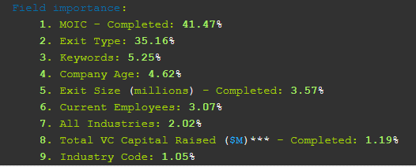
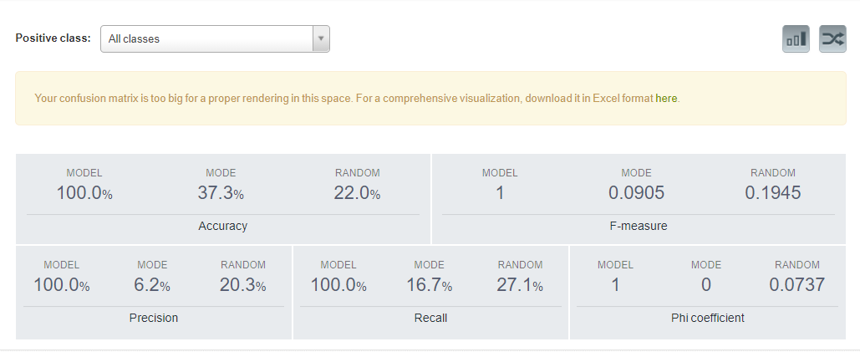
Modeling the clusters
Split our dataset into Training and Testing set in 4:1 ratio (Seed: 21).
The model was able to predict the cluster class with 100 % accuracy on testing set. This means each cluster has distinctive rules to define cluster class.

Slide 31
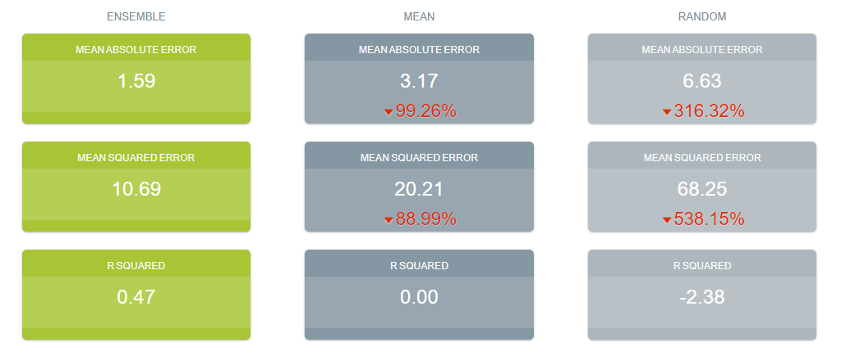
MOIC Model: Combined dataset
Important features identified during modeling of three dataset were combined to formed a dynamic dataset with all the important information about the companies, VC deals and their financial returns.
To evaluate that the combined dataset adds any value to the ability to predict return of investment of the company, dataset was used to train boosted trees ensemble model and tested with exclusive testing set.

Slide 32
Highlight Information
High return MOIC startups mainly located on the east coast and west coast of the USA, especially in New York and California.
Average return MOIC are high in IPO compare to other exit types such as buyout/LBO, M&A
Best industry verticals with respect to return of investment are Marketing Tech, Internet of Things and Big Data (Software & Technology)
Most of the company experience high return of investment between the age of 9 to 12.
The companies that have more employees will have higher return MOIC.
Return MOIC correlates positively with the number of employees, the higher the better and the best industry concerning the return of investments are Marketing Tech, Internet of things and Big Data (Software Technology).
Geographical locations do play a somewhat important role in demining the models’ successful prediction rate and other factors such as MOIC or Post Money valuation.

